Slide 1
Conventional Farming

Slide 2
Introduction
Conventional farming (also known as traditional farming or industrial agriculture) often refers to high input modern agriculture systems that include;
the frequent applications of synthetic chemical fertilizers, fungicides, insecticides, herbicides, high yielding cultivars, monoculture, GMO, heavy machinery, intensive tillage, and irrigation (Le Campion et al., 2020).

Slide 3
Conventional farming (CF) includes a large amount of chemical fertilizer and pesticide use to increase the yields per hectare.
Chemical and synthetic fertilizers and pesticides are not applied in the organic farming (OF) system to reduce their adverse environmental impacts.
Conventional farming is the use of seeds that have been genetically altered using a variety of traditional breeding methods, excluding biotechnology, and are not certified as organic.

Slide 4
Conventional farming is the use of seeds that have been genetically altered using a variety of traditional breeding methods,excluding biotechnology, and are not certified as organic.
Some conventional breeding methods have been used for thousands of years, often times to develop plants with faster growth, higher yields, pest and disease resistance, larger seeds or sweeter fruit.

Slide 5
Conventional crops may be grown simply as commodities and enter the commodity stream where they are mixed with other crops,
they may be grown to meet a requirement set forth by an end market, such as a specific chemical or nutritional requirement.
When conventional crops are targeted for a unique end market, farmers often receive premium prices.

Slide 6
Characteristics of Conventional Agriculture
The main purpose is the production of food (i.e., grain and vegetables), which is eventually removed from the farm
There is an imbalance between input and output because ‘along with the food products, soil, water, nutrients, and energy are also removed
Heavy reliance upon ‘high input of synthetic fertilisers and other agricultural chemicals, intensive tillage, and mono/limited rotation cropping systems’
High production input costs that include machinery, labor, chemicals, fuel, and tillage equipment’ which ‘are often not considered by producers, and the focus is on yield only’.
Monocultural production of crops/cereals

Slide 7
Negative Effects of Conventional Systems of Agriculture
The negative effects of conventional systems and practices are described as: •
Soil degradation, physically and biologically, where a significant amount of soil organic carbon (SOC) has been depleted with strong adverse impacts on soil functionality the dwindling of soil biodiversity and a decline in soil health
Stressing of the soil ecosystem that ‘drives declines in SOC and eventually degrades the soil’s capacity to overcome climate disturbances, such as drought and severe and frequent wet events’, with these events becoming more frequent and having ‘a devastating impact on crop productivity’

Slide 8
Conventional Tillage
Conventional tillage usually consists of primary tillage, or plowing, and secondary tillage, which is normally done by disking with harrows and maybe a third step with spring tooth harrows.
Conventional tillage has been used extensively by livestock as well as horticultural operations for years using smaller tractors available, and with working three point hitches.

Slide 9
Larger implements and tractors typically have hydraulic systems to raise and lower the implements as well.
Additionally, animal drawn tillage implements are very similar to small tractor drawn implements and while smaller, accomplish much the same as their engine powered engines.
Other forms of tillage have been developed in recent years, such as no-till, reduced till, and the partial replacement of moldboard plows with chisel plows.
All forms of tillage have their appropriate times and places to be used.

Slide 10
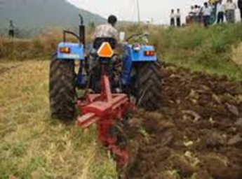

Slide 11
Conventional tillage can indeed harm the soil if it is done recklessly, or when conditions are too wet, or land is too steep, all the while contributing to soil and water erosion, compacted soils, and certainly uses of a lot of fossil fuel energy.

Slide 12
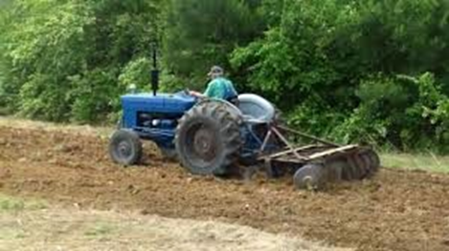

Slide 13
Different Stages of Tillage.
Step one is primary tillage and is the first step in the tillage process, and is normally done with a moldboard plow or a disc plough.
This step inverts the soil and exposes it to the surface
Moldboard plows have “bottoms”, or moldboards while disc plough have reversible discs
The typical small farm tractor can pull one, two, or three moldboards/discs.

Slide 14
Different Stages of Tillage.
The soil is turned over and exposed to agents erosion.
The disc plough is ideal for land preparations in fields that have a lot of trust. It can also be used for dry season ploughing
Moldboard can only effectively in wet conditions.
Ploughing opens the soils up for aerating and boosts the growth of microorganisms that improve fertility of the soil

Slide 15
The second step in tillage is “secondary tillage”, and is done by disking using disk harrows.
Typically you go over the field a couple of times to smooth out all of the mounds created by your moldboards from plowing.
A further refinement is to use a spring tooth harrow, to even further smooth out your seedbed.
Harrowing involves breaking down the soil into smaller particles which creates a finer texture that is easier for tree roots to penetrate.

Slide 16
Disadvantages of Conventional Tillage
Ploughing
Major soil erosion.
High soil moisture loss.
Timeliness considerations.
Highest fuel and labor costs.

Slide 17
Disadvantages of Conventional Tillage
Chisel ploughing
Little erosion control.
High soil moisture loss.
Medium fuel and labor requirements.

Slide 18
Disadvantages of Conventional Tillage
Disking
Little erosion control with more operations
High soil moisture loss
Destroys soil structure
Compacts wet soil.
No crop residues left in the field leading to little microbial activities

Slide 19
Plough Pan/Soil Compaction
A plow pan is a subsurface horizon or soil layer having a high bulk density and a lower total porosity than the soil directly above or below it as a result of pressure applied by normal tillage operations, such as plows, discs, and other tillage implements
Plough pans are partly caused by the base of the plough sliding along the furrow but also occur when the soil is wet, and there is some wheel slip which has a smearing effect on the bottom of the furrow.
Plough pans are more likely to form on the heavier types of soil with a high clay content.

Slide 20
Effect of Soil Compaction/Plough pans
Soil compaction is rearrangement of soil particles and reduction in macro-porosity and total pore space by stresses.
Stresses can be external such as those from machinery or internal from increasing pore water suction during drainage and drying.
The main cause of subsoil compaction on agricultural soils is cropping machinery, especially heavy air carts, harvesters and chaser bins.
Other stresses may come from tillage, stock trampling and overburden pressure.
Compact soils restrict crop and pasture production and increase nutrient leaching and emission of greenhouse gasses.

Slide 21
How to break a plough pan
Farmers use heavy equipment to break up hardpan.
If possible, hire a contractor to use a chisel plow to rip the hardpan.
Chisel plows penetrate through the hard layer and pull it upwards, shattering it into pieces.

Slide 22
Disadvantages of Conventional Land Preparations
If there are any residues left on farmers’ fields at the end of the dry season, they are raked up and burned.
Residues are a nuisance because they clog up the plough. Burning also aids the hunting of mice.
Burning is a very destructive habit and must be stopped. Residues protect the soil from sheet erosion, improve infiltration, reduce soil temperatures, which in October can rise to above 50oC, and protect top-soil from rain splash and capping.
Termites and other soil fauna incorporate residues into the soil, maintaining its structure and organic matter.

Slide 23
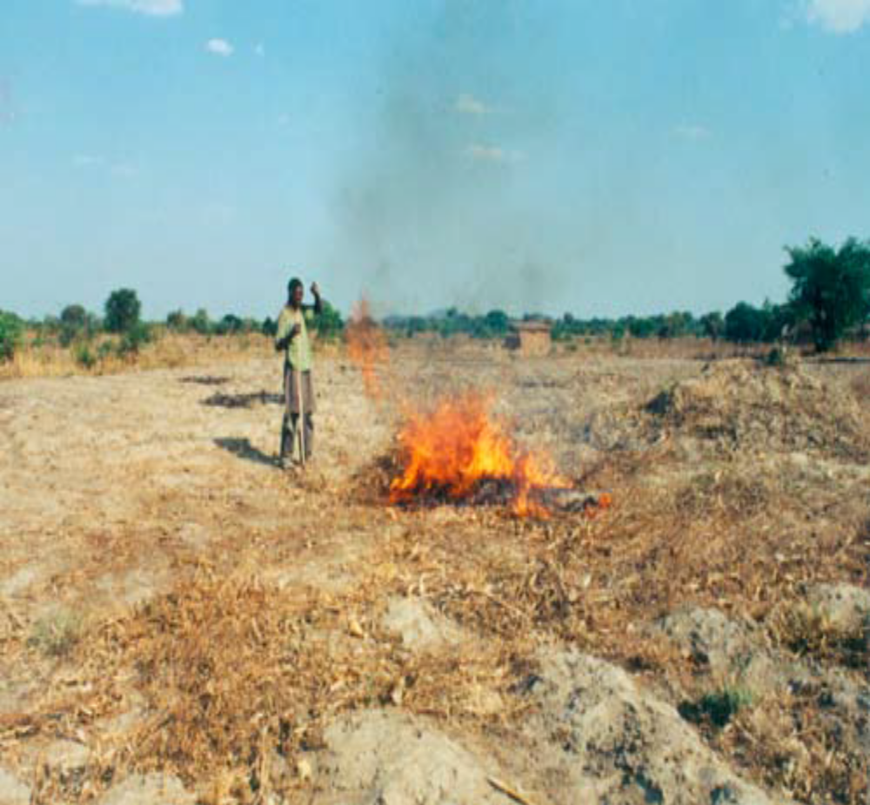
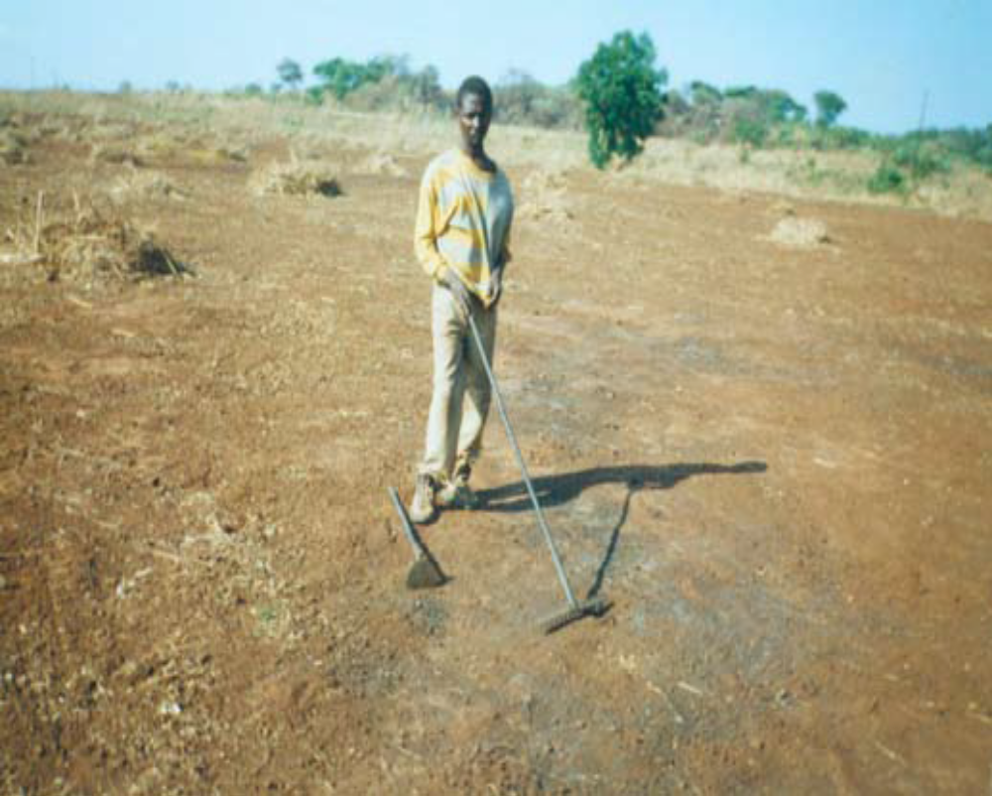
Many thousands of farmers in Zambia destroy a valuable resource called stover/residues. Residues improve rain infiltration and protect the top-soil from erosion and capping. Bare soil increases run-off and loss of soil.

Slide 24
PLOUGHING
Farmers have to wait for the rains to plough their land which always comes late.
For each day of delay after the first planting rains, 1.5% of potential Maize yield is lost.
Oxen in Zambia are smaller than they used to be and are of ten malnourished after the long dry season. Ploughing may take several days, or even weeks, if the early rains are unreliable. If farmers have to stop ploughing they also have to stop planting.
The ploughed soils are exposed to storms. Rain splash pulverises the surface causing capping, which encourages run of f and interferes with crop emergence.
If fertiliser has been used, up to 50% may be washed away.

Slide 25
PLOUGHING
Sowing seeds in the plough furrow leads to uneven emergence because some seeds will be planted too shallow and some too deep. By the time the farmer has finished ploughing his last plot, weeds are already infesting the earlier planted plots.
Farmers who plough are at the mercy of a tradition that wastes inputs, reduces yields and ultimately destroys the soils
Immediate Effects: Ploughing 18 days after first planting rains results in 25% loss of yield.
30% of seasonal rainfall and 50% of applied nutrients are also lost as storm flow.

Slide 26
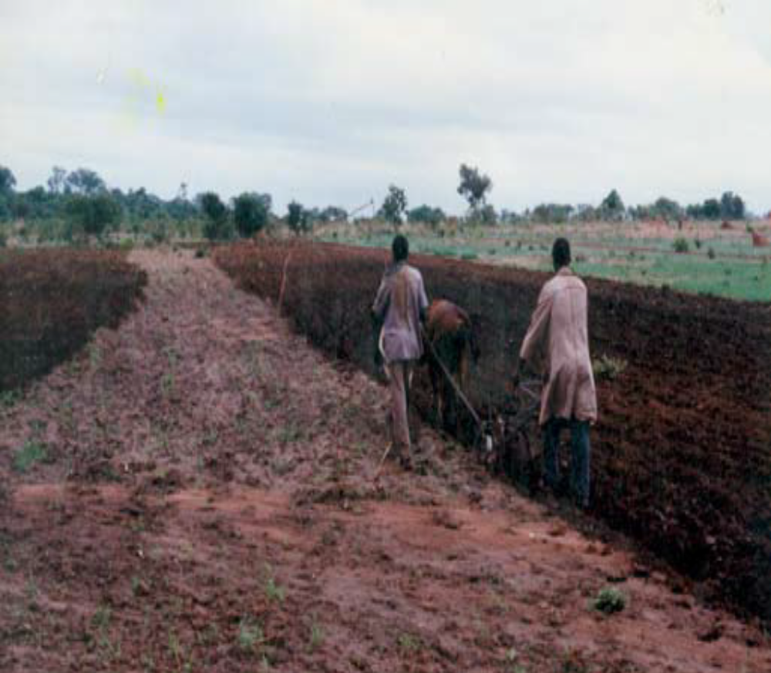
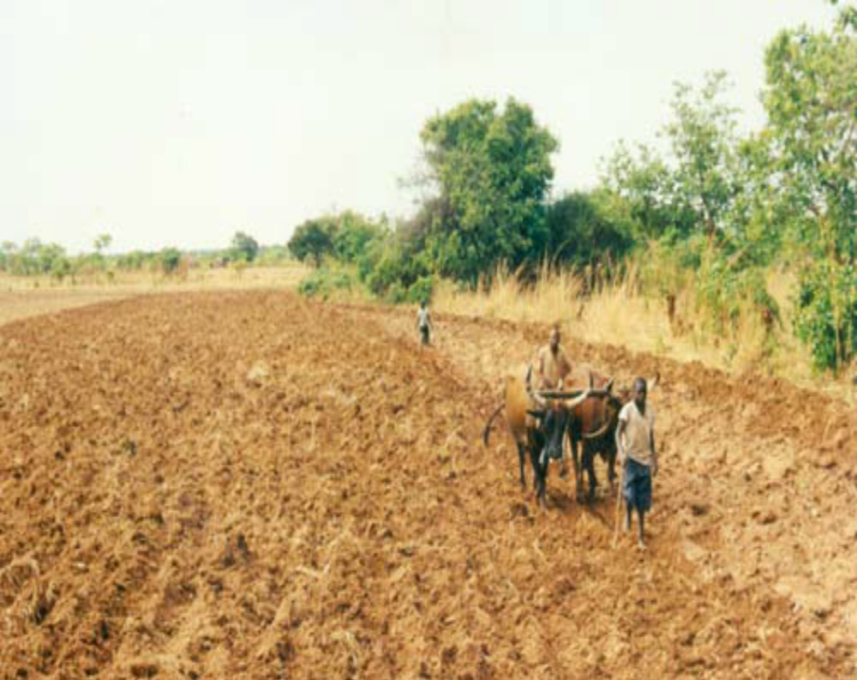

Slide 27
RIDGING
This practice is common in Eastern and Northern Provinces, and in Malawi. Ridges are split each year and new ridges are made in the previous season’s furrows.
If ridges are not made on the contour they accelerate erosion by concentrating rainfall into the furrow in which the hard subsoil acts like a drain.
Ridging is back breaking work and is done during the hottest time of the year when food stocks are low and the family is at its weakest.
Oxidised top-soil is moved backwards and forwards each year and a hoe pan is created under the ridges. Precious rainfall is lost and erosion gullies soon develop.
Trash, if present, is buried in the ridges. At the onset of the rains, bacteria use the early flush of Nitrogen to metabolise the residues leaving less nitrogen for the growing crops

Slide 28
Maize Mono-Cropping, Dry Spells and the Threat of Climate Change
Maize mono-cropping (planting Maize in the same field year after year), combined with the use acidifying fertilisers and conventional tillage, is a recipe for disaster.
Organic matter is oxidised, soil water holding capacity declines, hard pans develop, acidity increases and fertility declines.
Even in seasons of moderately poor rainfall, crops suffer during dry spells and yields are reduced. Late planting increases the problem and total crop failure of ten occurs. In this situation, farmers generally blame the weather and hope for food relief.
But after closer questioning they will of ten explain that their soils have changed and no longer produce crops like the used to!
Farmers cultivating degraded soils are particularly vulnerable to the threat of climate change.

Slide 29
DEFORESTATION AND LAND DEGRADATION
Land degradation and deforestation is increasing in Zambia. Conventional farming methods that rely on mining out the fertility provided by nature are a primary cause.
When the soils become exhausted, farmers look for virgin land where they can chop down the trees and start the destructive cycle all over again.
This is one reason why so many farmers migrated from Southern Province to the northern parts of Zambia.
It also explains why Zambia now has the 2nd highest deforestation per capita in the world.

